Slide 1
HTML Session 1
Basant Mohamed

Slide 2

What is HTML? (Hybrid Text Markup Language)
The standard markup language for creating Web pages
Describes the structure of a Web page
Consists of a series of elements
HTML elements tell the browser how to display the content

Slide 3

HTML History
HTML was created by Berners-Lee in late 1991 but was not officially released.
HTML 1.0 was released in 1993
Then comes HTML 2.0, published in 1995,
HTML 4.01 was published in late 1999 and was a major version of HTML.
HTML 5 at 2012

Slide 4

Let’s take a look

Slide 5
What is HTML element?
An HTML element is defined by a start tag, some content, and an end tag:
<tagname> Content goes here... </tagname>
HTML File Skelton:
<!DOCTYPE>
<html>
<head>......</head>
<body>......</body>
</html>
html
head
body

Slide 6

HTML Elements

Slide 7
HTML Attributes
HTML attributes provide additional information about HTML elements.
All HTML elements can have attributes
provide additional information about elements
specified in the start tag
name/value pairs like: name="value"
Ex:
<a href=”www.facebook.com”></a>
<img src=”image.png”>

Slide 8
HTML Attributes
Global Attributes : id , class ,style ,translate , tabindex, hidden
More: https://www.w3schools.com/tags/ref_attributes.asp

Slide 9
HTML Events
HTML has the ability to let events trigger actions in a browser, like starting a JavaScript when a user clicks on an element.
Window events:onload , onresize , onafterprint ,onbeforeprint,....etc
Mouse events : onclick , onmousedown , onmouseover ,....etc
Keyboard events : onkeyup , onkeydown , onkeypress ,...etc
Clipboard event : oncopy , onpaste , oncut

Slide 10
HTML Tags
<!DOCTYPE> : Identify type of file
<html></html> : start of actual file
<head></head> : contains <title> , <script> and <meta>
<body></body> : contains the fisable part
<h1></h1> , <h2></h2> ,<h3></h3>,<h4></h4>,<h5></h5>, <h6></h6> : Heading tags
<p></p> : to write paragraph
<br> : break line

Slide 11
HTML Tags
<a></a>: add link
<img> : add image
<button></button> : add button
<input> : add text field
<table></table>: create table
<ul></ul> : unordered list
<ol></ol> : ordered list
<form></from> : add form with inputs
<div></div>: add any element

Slide 12

Any Question ????

Slide 13
Head Tag
The <head> element is a container for metadata (data about data),
data about the HTML document and is placed between the <html> tag and the <body> tag.
Metadata is not displayed.
Metadata typically define the document title, character set, styles, scripts, and other meta information.
The HTML <head> element is a container for the following elements: <title>, <style>, <meta>, <link>, <script>, and <base>.

Slide 14
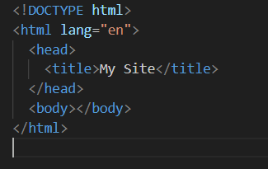

Title <title>
The <title> element defines the title of the document. The title must be text-only, and it is shown in the browser's title bar or in the page's tab.
The <title> element is required in HTML documents!

Slide 15
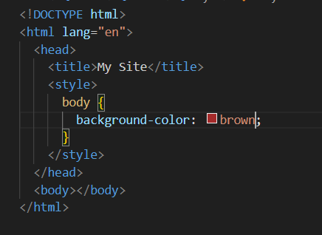
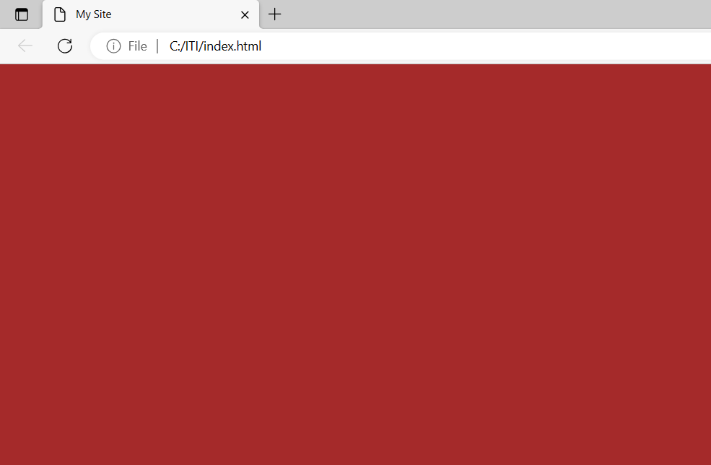
Style <style>
The <style> element is used to define style information for a single HTML page

Slide 16
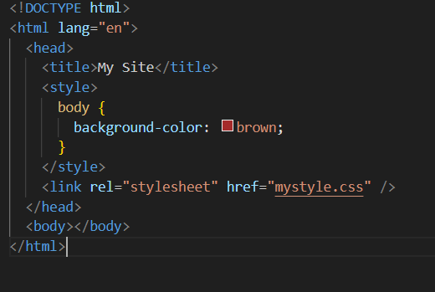
Link <link>
The <link> element defines the relationship between the current document and an external resource.
The <link> tag is most often used to link to external style sheets
Using link tag you can add favicon to display beside page title

Slide 17
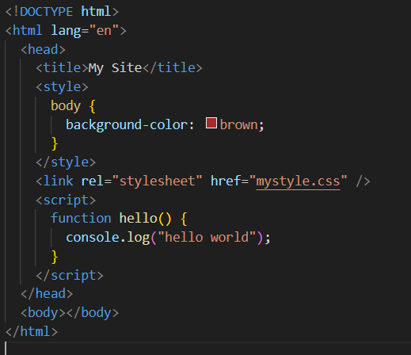
Script <script>
The <script> element is used to define client-side JavaScripts.
Note :
To More Info visit >>> https://www.w3schools.com/html/html_head.asp

Slide 18
Any Question ????

Slide 19
Body Tag
The <body> tag defines the document's body.
The <body> element contains all the contents of an HTML document, such as headings, paragraphs, images, hyperlinks, tables, lists, etc.
Note: There can only be one <body> element in an HTML document.

Slide 20
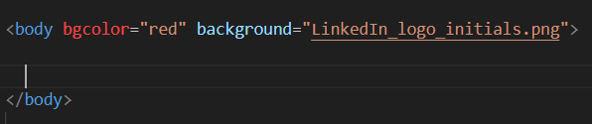
Body Attributes
The lang to define language.
The bgColor to define background color. (not used in HTML5)
The background to define background image.
The dir to define direction of page (rtl , ltr) color.

Slide 21
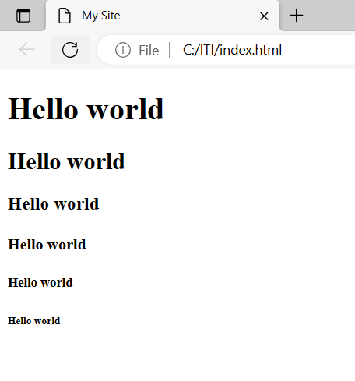
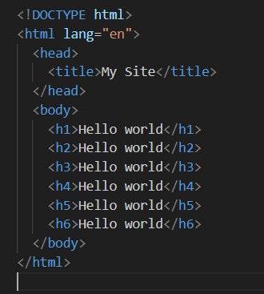
Heading
HTML headings are titles or subtitles that you want to display on a webpage.
Can take all global attributes

Slide 22
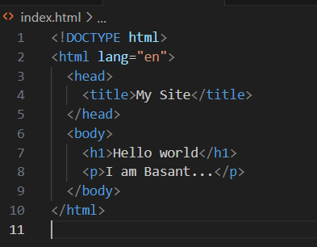
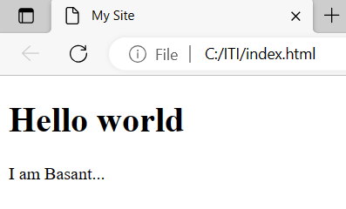
Paragraph <p>
A paragraph always starts on a new line, and is usually a block of text.

Slide 23
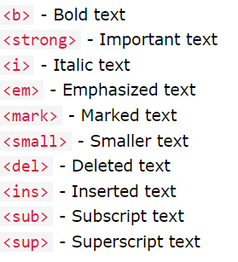
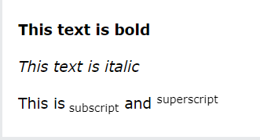
Text Formatting
Formatting elements were designed to display special types of text

Slide 24
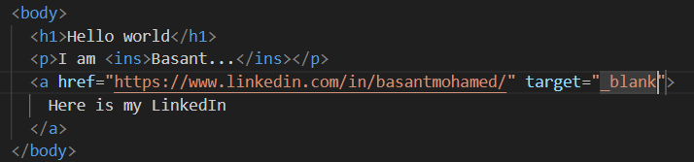
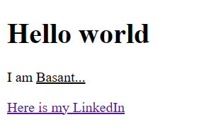
HyperLink <a></a>
You can click on a link and jump to another document.

Slide 25
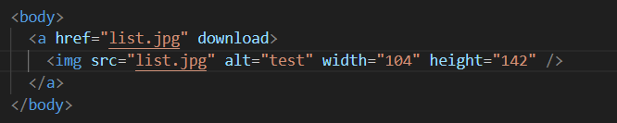
HyperLink Attributes
href: attribute, which indicates the link's destination
target : attribute specifies where to open the linked document (_blank , _self , _top , _parent)
download: Specifies that the target will be downloaded when a user clicks on the hyperlink
(only work if href is set)

Slide 26
Image <img/>
The HTML <img> tag is used to embed an image in a web page.
Images are not technically inserted into a web page; images are linked to web pages. The <img> tag creates a holding space for the referenced image.
src: attribute,Specifies the path to the image
alt: Specifies an alternate text for the image
hight , width: To define size of image in pixel

Slide 27

File Paths
Relative File Paths : A relative file path points to a file relative to the current page
Absolute File Paths : An absolute file path is the full URL to a file:

Slide 28
Div <div>
Span <span>
The <div> tag defines a division or a section in an HTML document.
The <div> tag is used as a container for HTML elements
By default, browsers always place a line break before and after the <div> element.
The <span> tag is an inline container used to mark up a part of a text, or a part of a document.

Slide 29
Any Question ????

Slide 30
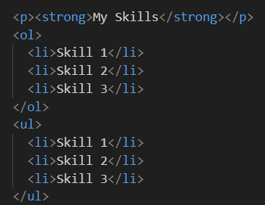
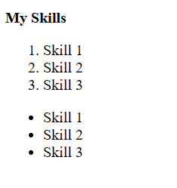
List
HTML lists allow web developers to group a set of related items in lists.
Ordered List : An ordered list starts with the <ol> tag. Each list item starts with the <li> tag
Unordered List : An unordered list starts with the <ul> tag. Each list item starts with the <li> tag.

Slide 31
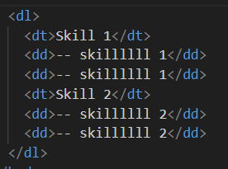
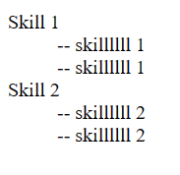
List
3) Description List : A description list is a list of terms, with a description of each term.
The <dl> tag defines the description list, the <dt> tag defines the term (name), and the <dd> tag describes each term

Slide 32
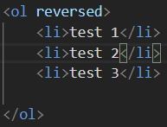
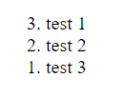
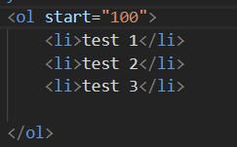

List Attributes
The reversed attribute is a boolean attribute. Used with <ol> to reverse the arrangement
The start attribute specifies the start value of the first list item in an ordered list.

Slide 33
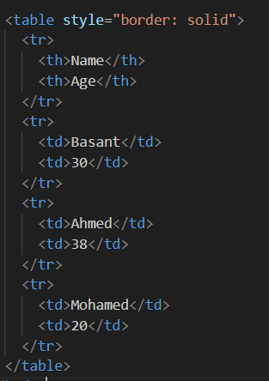
Tables
HTML tables allow web developers to arrange data into rows and columns.
<table> : table tag
<th> : head tag
<tr> : row tag
<td> : column tag
<caption> : to add caption to table
<colgroup>: to color group of columns

Slide 34
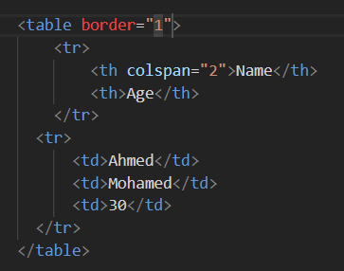
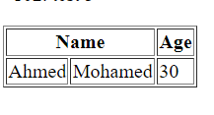
Table Attributes
Use the colspan attribute on the <th> element so you can have a header that spans over two or more columns to do this
Use border att to style the table border

Slide 35
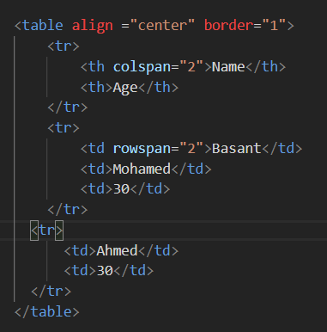
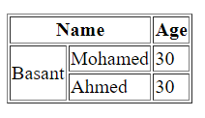
Table Attributes
To make a cell span over multiple rows, use the rowspan attribute
To align the table you can use align att with values center , right , left

Slide 36
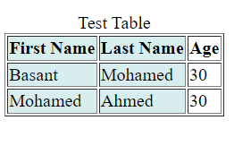
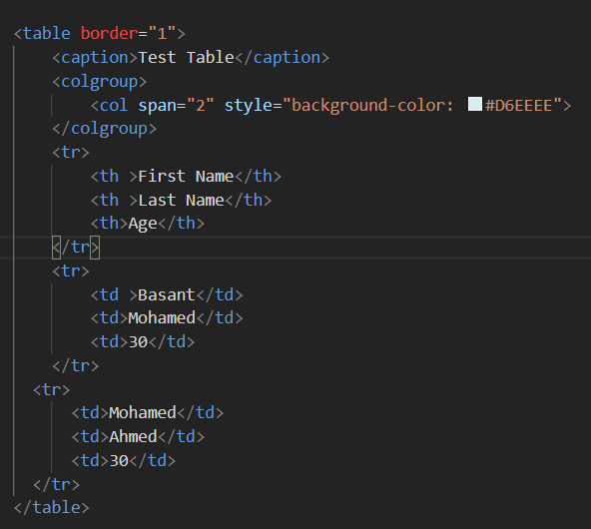
Table colgroup
The <colgroup> element is used to style specific columns in table
The <colgroup> element should be used as a container for the column specifications.
Each group is specified with a <col> element.
The span attribute specifies how many columns that get the style.
The style attribute specifies the style to give the columns.

Slide 37
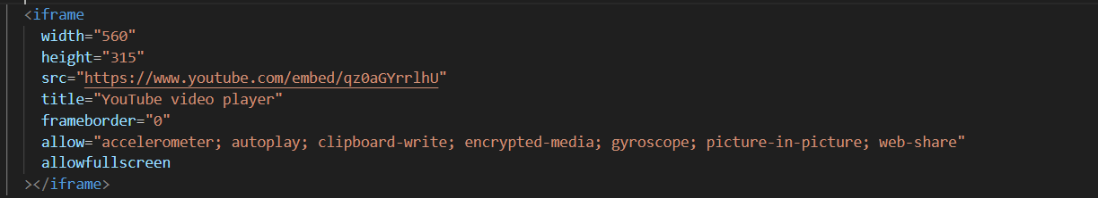
iFrame
An HTML iframe is used to display a web page within a web page.

Slide 38
Any Question ????

Slide 39
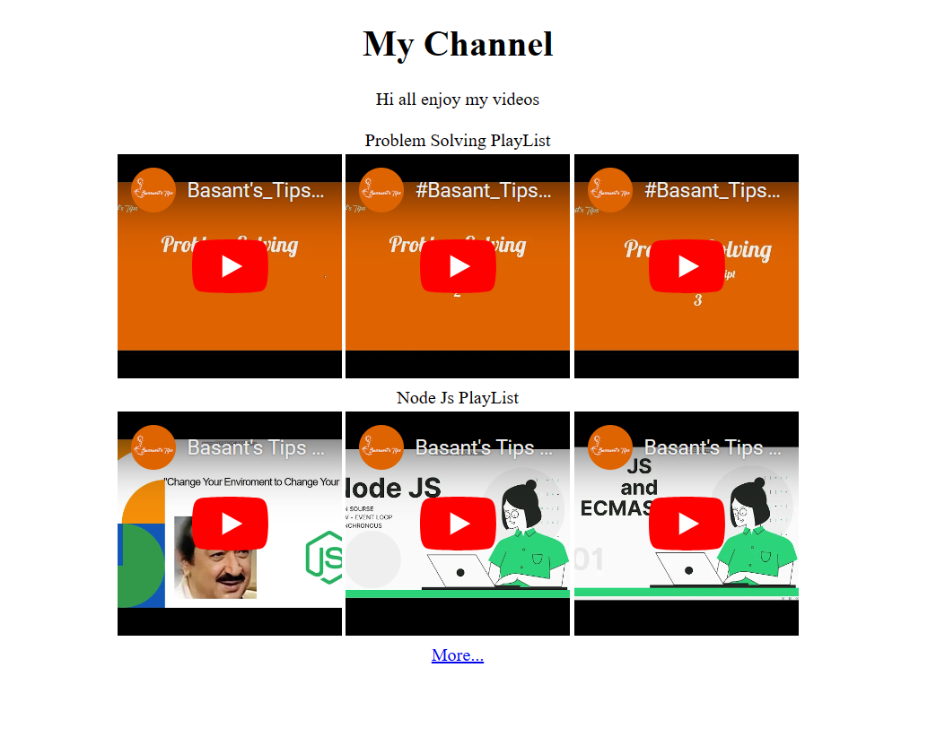
Task

